Slide 1
Malawi Compost Transporter
Connor Schmerfeld
Hope Williams
Shi Zhang
Husain Aldawood

Slide 2
Project Description
Initial Idea:
Full truck
Customized side-by-side
One year isn’t enough time
New Idea
Simple model
One aspect
Manageable with given time
Goal: Build a machine that is capable of transporting compost from one place to another in a small village in Malawi.
Easy to use and easy to maintain.
This project was created in order to help a poor country complete an everyday task much easier.
Client: Dr. McDonnell

Slide 3
Functional Decomposition
Building a Black Box model broke down the teams goal in short and simple steps. This helped the team to see the main what exactly we needed and helped us in our Concept Generation process.
Figure 1: Black Box Model

Slide 4
Concept Generation
Ways of loading/dumping
Side Loading/Dumping
Rear Loading/Dumping
Traction/Tires:
Offroad
Tracks
Foam-filled
Dumping mechanism
Hydraulics
Mechanical (Pulley)
Scissor Lift
Ways of Transportation
Hand pushed
Tricycle/bicycle
AC motor
Material
8020 Aluminum
Our concepts were generated largely based on our customer and client needs. For each part of the design, we came up with at least two different ways to satisfy these needs. These can be seen below in more detail.

Slide 5
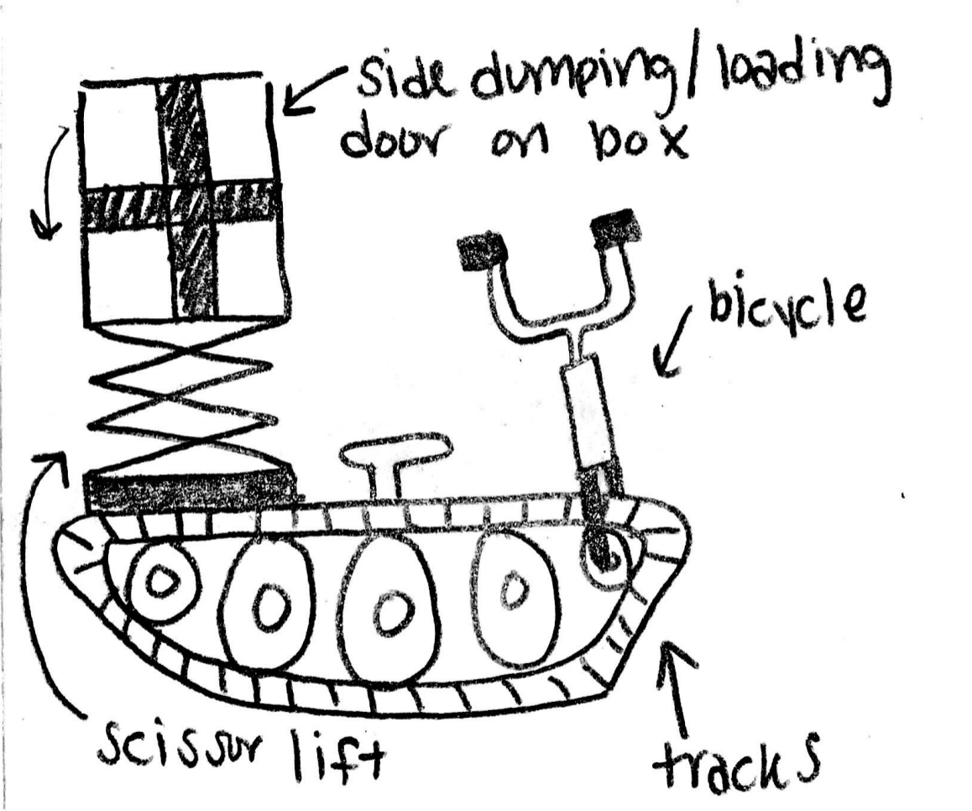
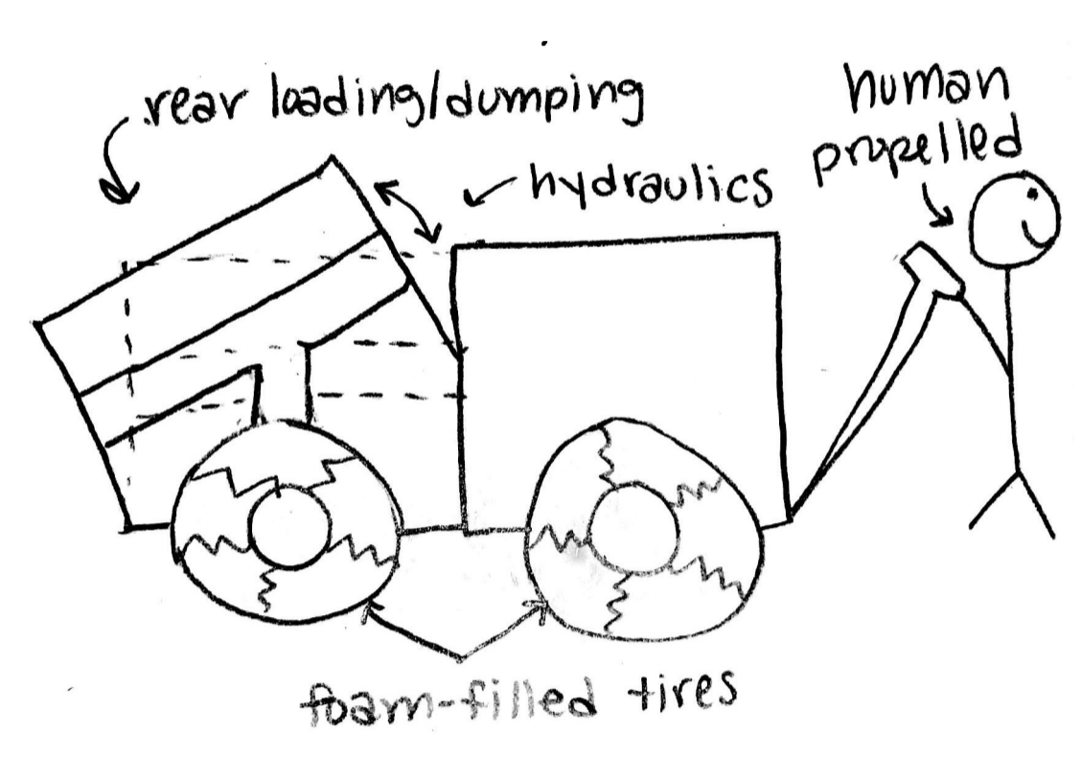
Potential Designs
To the left are some of the designs our team came up with. The design process for these designs is described in more detail in the following slides.
Design | Advantages | Disadvantages
Figure 2 | Tracks make the vehicle good with rough terrain Scissor lift can hold large loads | Heavy for one person to bike Tall and maybe hard to get compost in
Figure 3 | Rear loading/dumping system means less work to get compost out Foam-Filled tires are less likely to puncture | Can’t make device too big/heavy or it won’t be able to get pulled by one person Small capacity to hold compost
Figure 2: Potential Design 1
Figure 3: Potential Design 2

Slide 6
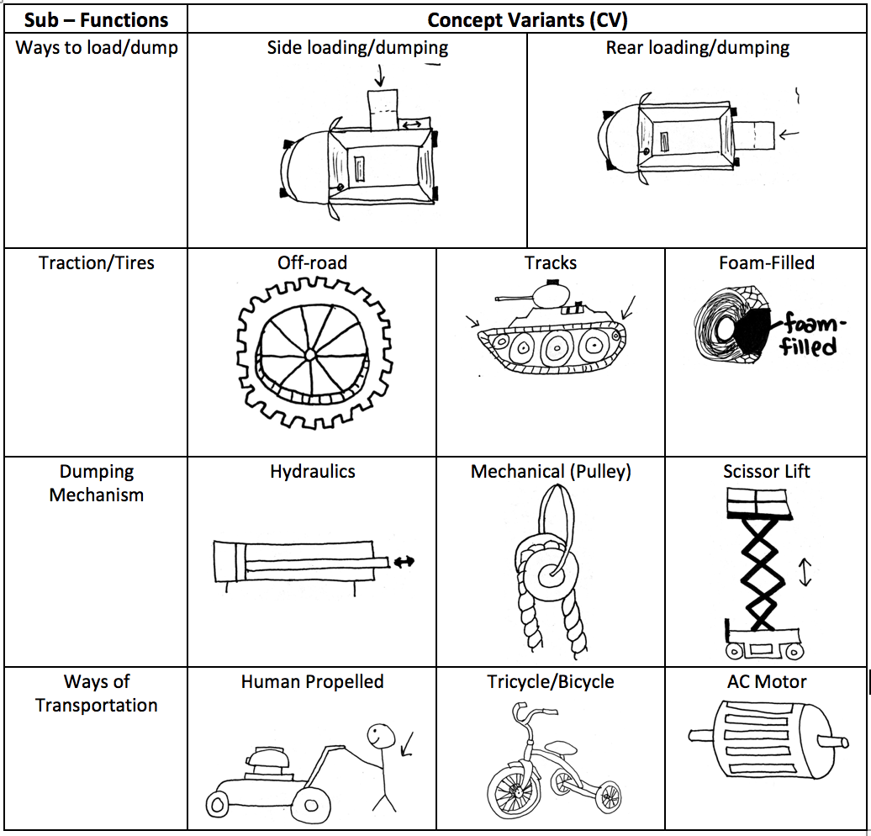
Concept Evaluation
Morphological Matrix
Figure 4: Morphological Matrix

Slide 7
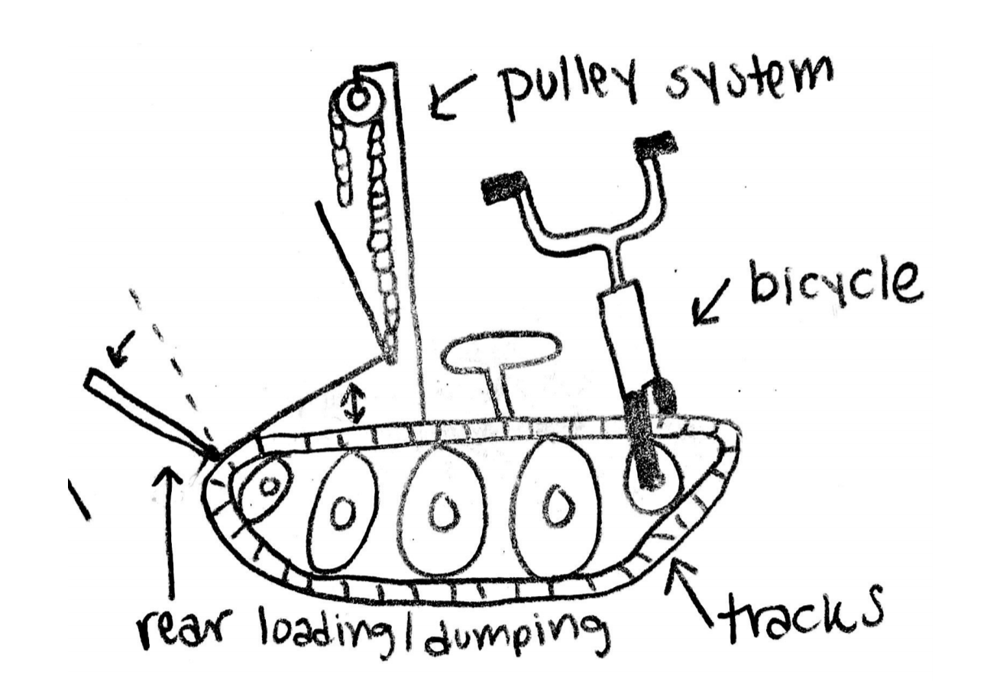
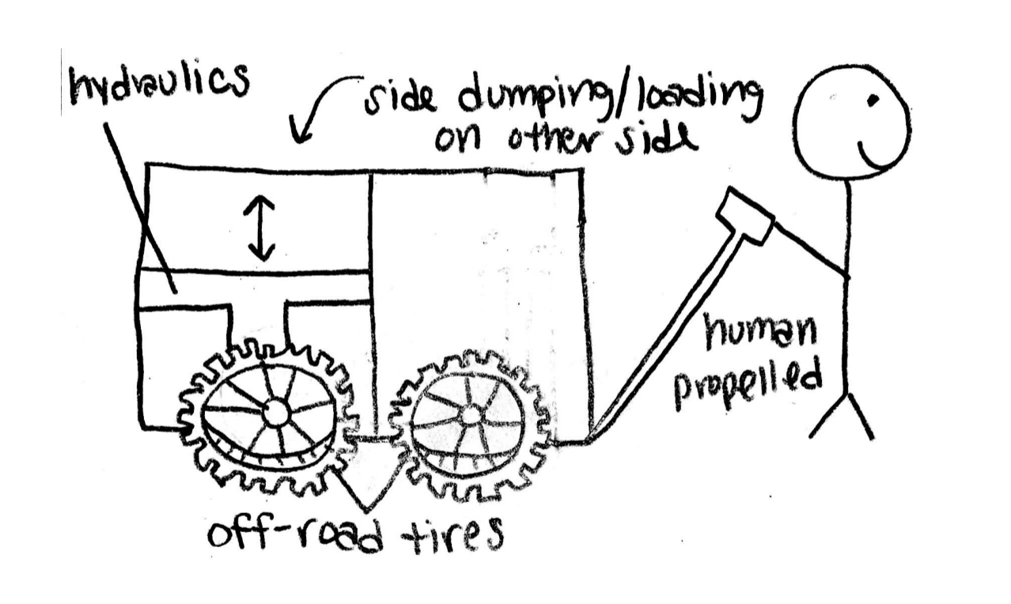
Design Alternatives
Figure 6: Design Alternative 2- bicycle on tracks
Figure 5: Design Alternative 1- off-road wagon
Figure 7: Design Alternative 3- scissor lift bicycle

Slide 8
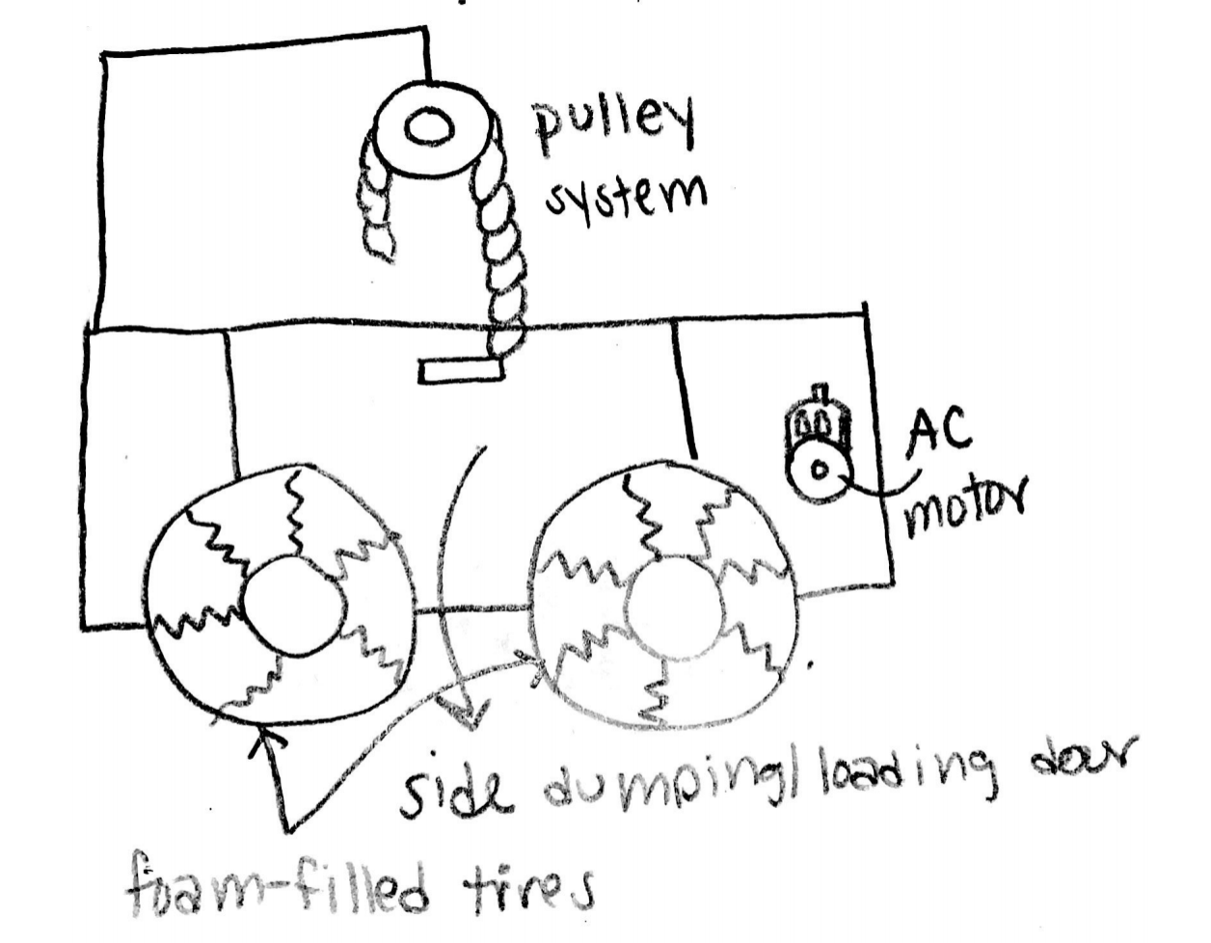
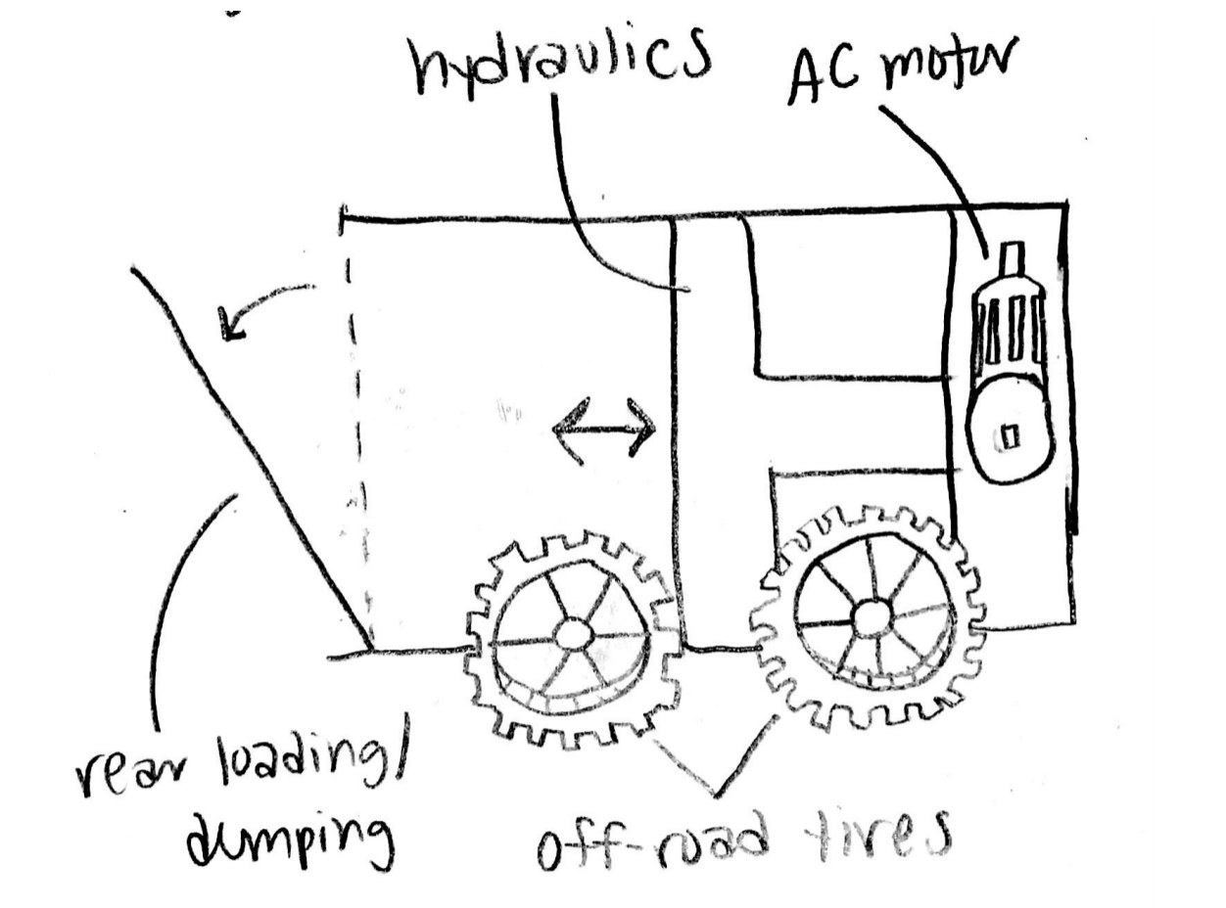
Design Alternatives
Figure 9: Design Alternative 5- pulley wagon
Figure 8: Design Alternative 4- off-road self-propelled wagon
Figure 10: Design Alternative 6- rear dumping/loading wagon

Slide 9
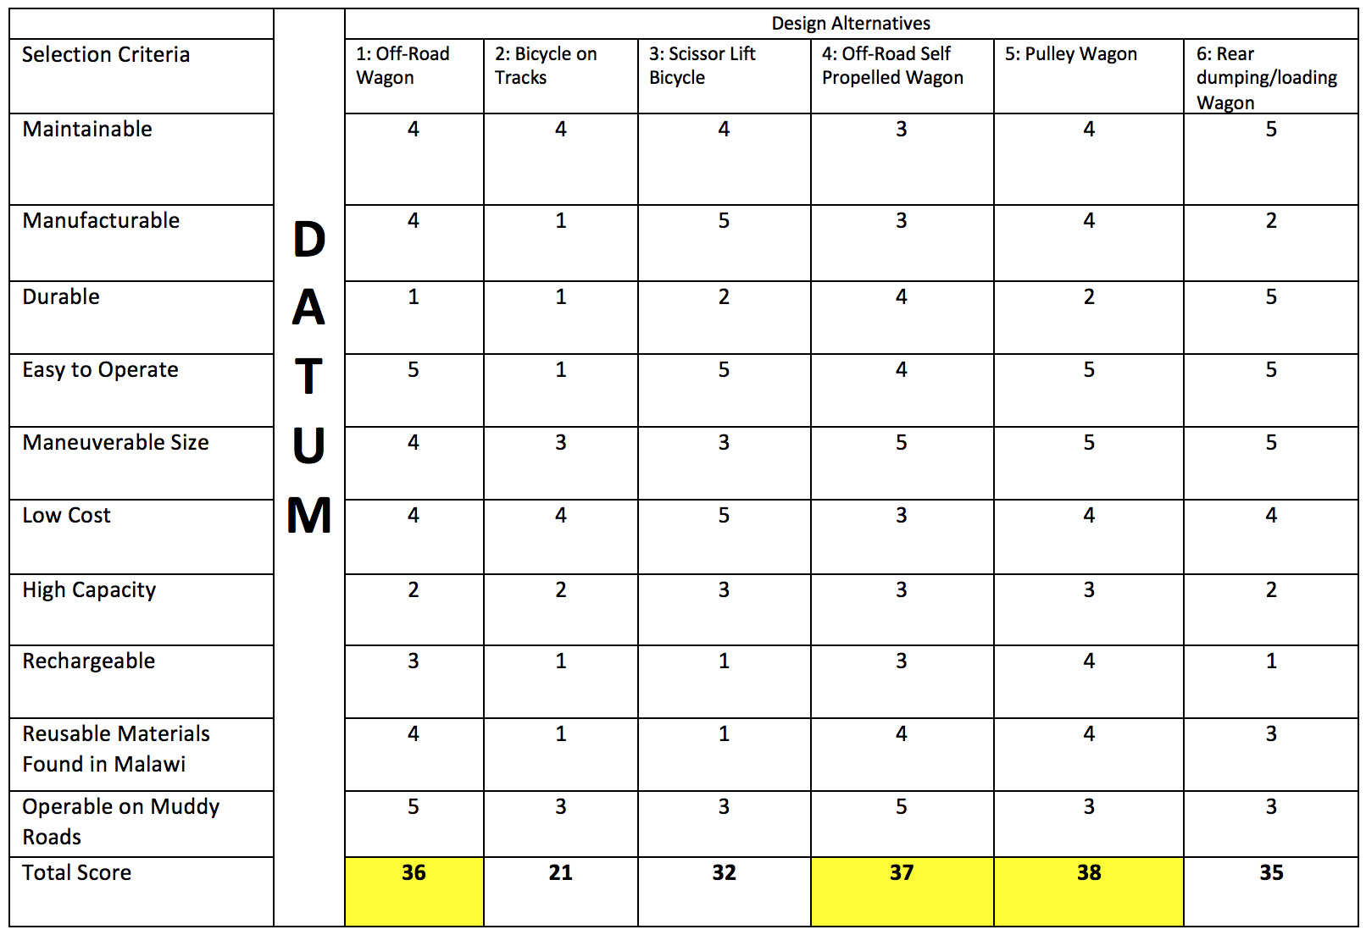
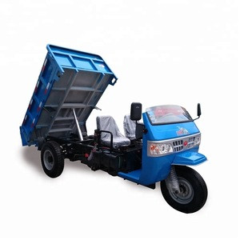
Pugh Chart
Table 1: Pugh Chart
To rank our designs based on our customer and client needs, we used a pugh chart and ranked the designs on a scale of 1-5. We chose our datum to be a design currently on the market we liked.
[1]
Figure 11: Datum

Slide 10
Top 3 designs
2ND PLACE DESIGN:
Based on the Pugh Chart, the top 3 designs that meet our customer and client needs are as follows:
1ST PLACE DESIGN:
Figure 13: Design Alternative 4- off-road self-propelled wagon
3RD PLACE DESIGN:
Figure 12: Design Alternative 5- pulley wagon
Figure 14: Design Alternative 1- off-road wagon

Slide 11
Decision Matrix
To better rank the top 3 designs, the team made a decision matrix. The results can be seen below.
Table 2: Decision Matrix
 |  | Off-Road Wagon |  | Off-Road Self Propelled Wagon |  | Pulley Wagon
Criteria | Weight (%) | Score | Weighted Score | Score | Weighted Score | Score | Weighted Score
Increase Power | 15 | 1 | 0.15 | 4 | 0.6 | 4 | 0.6
Small Dimensions | 20 | 5 | 1 | 2 | 0.4 | 2 | 0.4
Increase Waste Capacity | 25 | 3 | 0.75 | 3 | 0.75 | 4 | 1
Increase Battery Life | 10 | 1 | 0.1 | 3 | 0.3 | 2 | 0.2
Decrease Weight | 10 | 5 | 0.5 | 3 | 0.3 | 3 | 0.3
Decrease Manufacturing Cost | 20 | 5 | 1 | 1 | 0.2 | 1 | 0.2
Total |  |  | 3.1 |  | 2.55 |  | 2.7

Slide 12
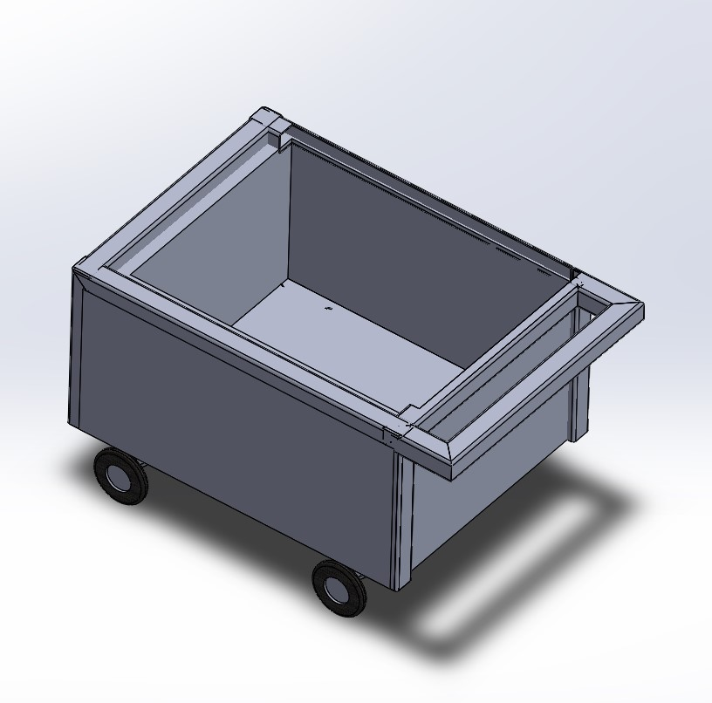
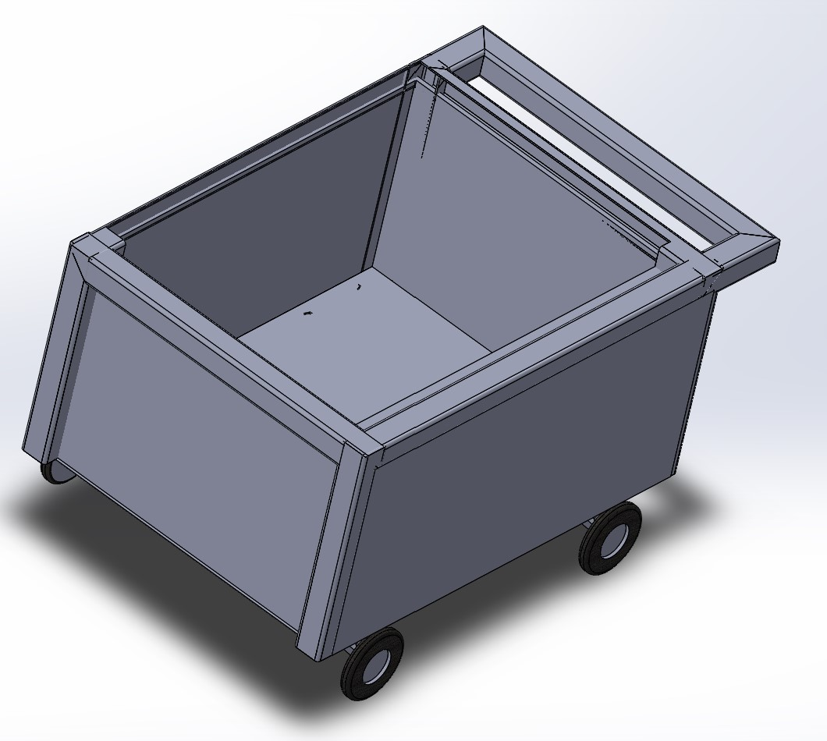
Rough CAD model of current design
The best design based on the decision matrix is the off-road wagon. A rough CAD model of this can be seen to the right.
The final design meets the initial engineering requirements by being :
Easy to Operate
Low Cost
High Capacity
Maintainable
Manufacturable
Etc.
Figure 16 & 17: Rough CAD Model
Figure 15: Best Design so far

Slide 13
Budget Planning
Bill of Materials
Table 3: Bill of Materials
Item # | Description | Vender | Quantity (#) | Price ($)
1 | Off-Road Tires | GoPowerSports | 4 | 200
2 | Hydraulic System | TBD | 1 | TBD
3 | 80/20 Cart | 80/20 Inc. | 1 | $581
4 | 80/20 side door | 80/20 Inc. | 1 | $45
5 | Motor | Electric Motor Warehouse | 1 | $100-400
~$1,000 dollars so far being used
At least $500 left over
Prototyping/Different parts

Slide 14
Conclusion
Still a lot to do
Next step is to finalize a design
Conduct a design analysis
Finalize Materials needed
Start collecting materials

Slide 15
References
[1] “Trade Wheel,” TradeWheel. [Online]. Available: https://www.tradewheel.com/p/farm-dump-truck-3-wheel-diesel-666378/.

Slide 16
QUESTIONS?

